Slide 1
DOCUMENTATION

Slide 2
What is Documentation?
Documentation is the means through which scholarly conversations are recorded.
Notes:
It is not simply giving generic credit to the source. It is for the reader.

Slide 3
8th Edition
Flexible
Elements common to all sources are considered
Include traditional and modern sources
Focus on the visible features than the format(web/print)

Slide 4
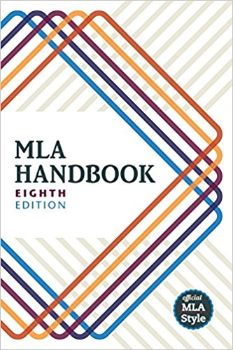

Slide 5
The question of why?
Credibility matters
Acknowledging the source
For a plagiarism free world
Integrity and authenticity

Slide 6
STYLES DECIDE THE MANNER
MLA (MODERN LANGUAGE ASSOCIATION OF AMERICA)STYLE
APA(AMERICAN PSYCHOLOGICAL ASSOCIATION) STYLE
HARVARD REFERENCING STYLE
CHICAGO STYLE

Slide 7
MLA STYLE
Founded in 1883 in New York
Simple
Used in the field of language and literature
MLA style sheet– 1951
Editions in 1977,1984,1988,1995,1999, 2003 ,2009 and 2016

Slide 8
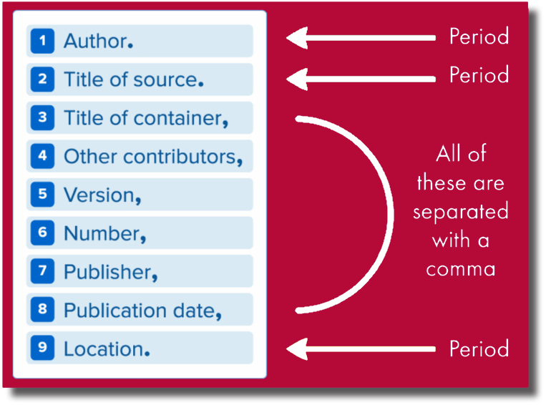
Latest edition’s features
Flexible
Missing info- N.p. , N. pag. , & n.d.
Notes:
Represents a consensus among teachers, scholars, and librarians in the field of language and literature

Slide 9
TITLES OF QUOTED WORKS

Slide 10
Italicize
Books
Plays
Periodicals
Web sites
Films
CDs
Title as it appears on the title page
Capitalize the first word, last word & all the main words

Slide 11
With in quotations
Articles
Essays
Stories
Poems
Chapters
Individual Episodes
Unpublished Works,
Lectures, Speeches and titles in regional languages

Slide 12
QUOTATIONS

Slide 13
Put a colon before the quotation– if it is formally introduced
Comma or no punctuation for integrated quotation
Quotation inside the quotation ,use single quotation marks
Keep exact internal punctuation
Put comments and emphasising in square brackets

Slide 14
QUOTATIONS
Up to four lines
We see so many global warming hotspots in North America likely because this region has “more readily accessible climatic data and more comprehensive programs to monitor and study environmental change . . .” (“Impact of Global Warming” 6).

Slide 15
More than four lines
The novel presents the view that there are multiple interpretations of history:
History…the world, the universe, all human life, and so, too, every institution under which we live…is in a constant state of evolution. The world and every thing in it is being created and recreated…each hour, each day, each week going through the unending process of birth and rebirth which has made us all. ( Tharoor 266)

Slide 16
ELLIPSIS
3 Ellipsis points to refer to the omitted material
Renen emphasizes the cultural roots of nationalism, arguing that “nationalism has to be understood by aligning . . . but with the large cultural systems that precede it, out of which-as well as against which-it came into being”(19).

Slide 17
FOUR PERIODS ELLIPSIS
Original:
It would seem that we in the post colonial world shall only be perpetual consumers of modernity. Europe and the Americas, the only true subjects of history, have thought on our behalf not only the script of colonial enlightenment and exploitation, but also that of our anti-colonial resistance and post colonial misery. (Chatterjee 216).

Slide 18
Example
It would seem that . . . . Europe and the Americas, the only true subjects of history, have thought on our behalf not only the script of colonial enlightenment and exploitation, but also that of our anti-colonial resistance and post colonial misery. (Chatterjee 216).

Slide 19
Ellipsis in square brackets
Original text
We live in california, my husband and I, Los Angeles. . . . This is beautiful country; I have never been here before( House Made of Dawn)
In Elizabeth’s House Made of Dawn, when Mrs. St. John arrives at the rectory, she tells Father Olguin, “ We live in California, my husband and I, Los Angeles. . . . This is beautiful country [. . .]” (29).

Slide 20
PARENTHETICAL DOCUMENTATION

Slide 21
Work by single author
Without Name
Wordsworth stated that Romantic poetry was marked by a “spontaneous overflow of powerful feelings” (263).

Slide 22
Work by single author
With the Name of the Writer
Romantic poetry is characterized by the “spontaneous overflow of powerful feelings” (Wordsworth 263).

Slide 23
Authors with same last names, give initial:
(R. Miller 24) (A. Miller 32)
If the initials too became same
(Benedict Anderson 12) (Barry Anderson 56)
Multiple works by the same author
(Fry, Anatomy 125) (Fry, Archetypes 57)

Slide 24
Work by more than one author
Smith, Yang, and Moore argue that tougher gun control is not needed in the United States (76).
The authors state "Tighter gun control in the United States erodes Second Amendment rights" (Smith, Yang, and Moore 76).
Legal experts counter Smith, Yang, and Moore's argument by noting that the current spike in gun violence in America compels law makers to adjust gun laws (Smith et al. 76).
Notes:
Et al. meaning and others (Latin phrase)

Slide 25
Corporate author : full or shortened title
The quality of research is in a “dismal state in the contemporary world” (National Research Council 230).
Unknown author– title in shortened or full
We see so many global warming hotspots in North America likely because this region has “more readily accessible climatic data and more comprehensive programs to monitor and study environmental change . . .” (“Impact of Global Warming” 6).

Slide 26
Classic works with multiple editions
Page number – semicolon-- chapter or book no.
Marx and Engels described human history as marked by class struggles (79; ch. 1).
In Vindication of the Rights of Woman, Mary Wollstonecraft recollects many “women who, not led by degrees to proper studies, and not permitted to choose for themselves, have indeed been over grown children”(185; ch.13,sec. 2).

Slide 27
Multivolume works
Volume– colon-- space --page number(s)
. . . as Quintilian wrote in Institutio Oratoria (1: 14-17)
.
Indirect sources
Ravitch argues that high schools are pressured to act as “social service centers, and they don't do that well“ (qtd. in Weisman 259).

Slide 28
Multiple citations in a single parenthesis
. . . as has been discussed elsewhere (Arnold 3; Eliot 21).
Drama, verse plays and poems
Mention divisions--act, scene,canto, book, part--&,parts
(Iliad 9.19) (Hamlet V.1 5—10 )

Slide 29
Interviews, Editorials, Articles
Author’s last name, Shortened title
(Varadarajan, Interweaving)
Movies
Title of the film or Director’s name
(Cameroon) (Avatar)

Slide 30
REFERENCE

Slide 31
Work cited, bibliography, select
Arrange entries in alphabetical order
Begin each entry flush with the left margin
Entries run more than one line, indent the subsequent lines one half inch from the left margin (hanging indention)

Slide 32
Works Cited Page: Books
Name of the author in reverse order
In general, omit titles, affiliations, and degrees that precede or follow names.
When an organization is both author and publisher, begin the entry with the work’s title, skipping the author element, and list the organization only as publisher. Do not include The before the name of any organization in the works-cited list.
Title of Book.
Titles should be stated in full in the works-cited list, including any subtitles.
Regardless of where a title appears in your project—in the main text or in the works-cited list—its capitalization, punctuation, and presentation in italics or in quotation marks
Publisher,
Year of Publication

Slide 33
Single Author
Gleick, James. Chaos: Making a New Science. Penguin, 1987, pp.34-35.
Richard, Ivor Armstrong. Principles of Literary Criticism. U of Pennsylvania, 2007, p.227.

Slide 34
MORE THAN ONE AUTHOR
Hutchinson, Linda, and Michael Hutchinson. Bodily Charm: Living Opera. University of Nebraska , 2000, p.456.

Slide 35
MORE THAN THREE AUTHORS
Trivedi, Harish, et al. Indian English Fiction. Ravi Dayal , 1985, p.98.
or
Trivedi, Harish, Vijayashree, Vijayarakhavan, and Meenakshi Mukherjee. …….

Slide 36
TWO OR MORE WORKS BY THE SAME AUTHOR/S
Order the entries alphabetically by title
Three hyphens in place of the author's name for every entry after the first
Gilbert, Sandra M., and Susan Gubar, editors. Mad Woman in the Attic
---. The Female Imagination. Gordon, 1986, pp. 46-48

Slide 37
SAMPLE
Burke, Kenneth. A Grammar of Motives. [...]
---. A Rhetoric of Motives. [...]
---, Editor. Wallace Stevens: A Collection of Critical Essays. Oxford UP, ...

Slide 38
Corporate author
American Allergy Association. Allergies in Children. Random, 1998, p.45.
Scholarly edition
Bronte, Charlotte. Jane Eyre. edited by Margaret Smith, Oxford UP, 1998,p.78.

Slide 39
Subsequent edition
Selden, Raman, and Peter Widdowson. A Reader’s Guide to Contemporary Literary Theory, 3rd edition, Oxford UP, 2006.
A Translation
Foucault, Michel. Madness and Civilization: A History of Insanity in the Age of Reason. Translated by Richard Howard, Vintage-Random House, 1988.
Republished book
Butler, Judith. Gender Trouble. 1990, Routledge, 1999.

Slide 40
ANTHOLOGY/COMPILED/EDITED WORK
Begin with the name of the editor or compiler,
Put a comma and Editor.
If the person has done two things mention both as they appear on the title page

Slide 41
Peterson, Nancy J., Editor. Toni Morrison: Critical and Theoretical Approaches, Johns Hopkins UP, 1997. p.78
Bhatnagar, K.M., and Vijayashree, Editors. Partition and Indian English Fiction
Davis, Anita Price, Compilers. North Carolina during the Great Depression
Kepner, Susan Fullop, Editor and Translator. The Lioness in Bloom: Modern Thai Fiction about Women

Slide 42
A WORK IN AN ANTHOLOGY
Essay/poem/story
Tiffin, Helen. “Reinventing Imagined Communities”. National Narratives in Postcolonial Fiction, Edited by Harish Trivedi, Oxford UP,2007, pp.125—135.
Burns, Robert. "Red, Red Rose.” 100 Best-Loved Poems, Edited by Philip Smith, Dover, 1995, p. 26.

Slide 43
ARTICLE IN A REFERNCE BOOK
Encyclopedias/Dictionaries
"Ideology." The American Heritage Dictionary, 3rd ed., 1997.
“Nigerian Literature.” The Encyclopedia Americana. 2004 Ed.

Slide 44
Introduction/ Preface/ Foreword
Barry, Peter. Introduction. Beginning Theory: An Introduction to Literary and Cultural Theory.Viva Books, 2008. pp.1-10.
Un-published Dissertation
Rajan, Anjana. “Interior Monologue in Mark Twain.” Dissertation, U of Delhi, 1998.
Rajan, Anjana. “Interior Monologue in Mark Twain.” Dissertation,U of Delhi, 1998, Rupa Publications, 2002.

Slide 45
ARTICLE IN A JOURNAL
Author(s)./ "Title of Article.“/ Title of Journal/ Volume, /Issue No,/Year, pages.
Kumar, Praveen. “Ecological Concerns in The Mayor of Casterbridge.” Littcritt, Vol. 40, Issue 3, 2006, pp.38-42.

Slide 46
Sample
Bagchi, Alaknanda. "Conflicting Nationalisms: The Voice of the Subaltern in Mahasweta Devi's Bashai Tudu." Tulsa Studies in Women's Literature , Issue 15 ,1996, p. 41+.
Burgess, Anthony. “Politics in the Novels of Graham Greene.” Literature and Society, Spec. issue of Journal of Contemporary History, Vol 2, Issue 2, 1967, pp. 93-99.

Slide 47
Article in a Magazine
Mandar, Harsh. “Communal Politics.” Frontline, 30 July 2006, pp. 26-28.
Article in a News Paper
Krugman, Andrew. "Fear of Eating." New York Times, 21 May 2007, late ed., p. B7+
Sidharth, P. “Plight of Vidharbha.” Hindu, 10 Dec. 2006, p. 10.

Slide 48
Review
Babu, Suresh. “Historicizing Fiction.” Rev. of Sea of Poppies, by Amitav Gosh, Hindu Magazine , 21 Sept. 2007,p. 5+
An Editorial
Varadharajan, Sidharth. “Ethics of Anti-Curruption Campaign.” Hindu,July 2011,p. 5.

Slide 49
An Interview
Gordimer, Nadine. Interview. New York Times, 10 0ct. 1991, late ed., p.25.
Deshpande, Shashi. “Politics of Silence.” Interview by Kalpana Sharma, Hindu Literary Review, 4 Dec. 2008.
Vijayan, O V. Personal interview. 22 July 1998.

Slide 50
Film
It’s a Wonderful Life. Directed by Frank Capra, Performed by James Stewart, Donna Reed, and Lionel Barrymore, RKO, 1946.
It’s a Wonderful Life. Directed by Frank Capra. Performed by James Stewart, Donna Reed, and Lionel Barrymore, RKO, 1946. Republic, 2001, disc 3.
A painting
Goya, Francisco. The Family of Charles IV, 1800, Museo del Prado, Madrid.

Slide 51
Web
Evaluating criteria- Currency, Relevance, Authority, Accuracy
Name of the author(Pseudonyms can also be included)
Title of the book or article
Title of the over all web(e.g. Twitter)
Publisher or sponsor
Date of publication(time if given can be included)
URL

Slide 52
Bernstein, Mark. “10 Tips on Writing the Living Web.” A List Apart: For People Who Make Websites, 16 Aug. 2002,www.alistapart/for-people-/who?/makeit
Dolby, Nadine. “Research in Youth Culture and Policy: Current Conditions and Future Directions.” Social Work and Society: The International Online-Only Journal , Vol.6, No.2, 2008.

Slide 53
Wiki
"Cultural Influence of Star Trek." Wikipedia: The Free Encyclopedia, Wikimedia Foundation.

Slide 54
E mail
Use the subject as the title.
E.g:-
Boyle, Anthony.T. “Re: Utopia.”Received by Daniel J. Cahill, 21 June 1997.

Slide 55
Television Series
“Hush”. Buffy , the Vampire Slayer, created by Jose Whedon, performance by Sarah Michelle, season 4, episode 10, Mutant Enemy, 1999.

Slide 56
Change to MLA 8th Edition
Ahmad, Aijaz. “Nationalism and the Peculiarities of the Indian.” Nation in Imagination: Essays on Nationalism, Sub- Nationalism, and Narration. Eds. Harish Trivedi, et al. Hyderabad: Orient Longman, 2007. 37-57. Print.
An Inconvenient Truth. Dir. Davis Guggenheim. Perf. Al Gore, Billy West. Paramount, 2006.Film.
Bhabha, Homi K. The Location of Culture. London: Routledge, 1994. Print.

Slide 57
Change to 8th Edition
---, ed. Nation and Narration. London: Routledge, 2002. Print.
Bose, Brinda., ed. Amitav Ghosh: Critical Perspectives. New Delhi: Pencraft, 2005. Print.
Bronte, Charlotte. Jane Eyre. Ed. Margaret Smith. Oxford: Oxford UP, 1998. Print.

Slide 58
Cite as per MLA 8th Edition
Interview with Bill Clinton.
Interview by Andrew C. Revkin.
Title “Clinton on Climate Change.”
Published in New York Times.
Date: 23 May 2007.
Farrell, Thomas B.
Introduction.
Year:1993 page no.s 1-13
Norms of Rhetorical Culture.
publisher Yale UP

Slide 59
Pick the correct one.
Homer. The Odyssey. Trans. Robert Fagles. New York: Viking, 1996.
Homer. The odyssey. Translated by Robert Fagles, New York: Viking, 1996. Print.
Homer. The Odyssey. Translated by Robert Fagles, Viking, 1996.
Homer. The Odyssey. Translated by Robert Fagles. Viking, 1996

Slide 60
THANK YOU

